Slide 1
Mcsim Python toolbox
How to structure it?
Mathias Marley, Feb 2022

Slide 2
Intro
Need Python 3DOF and 4DOF maneuvering model of RVG for Endure project
Serves as basis for MCsim Python
Use an intuitive structure and workflow so that future models/projects follow a similar format
(I will not create a «complete» toolbox)

Slide 3
Some Python nomenclature
A script is a python file that does something. E.g. demo_sim_RVG.py runs a demonstrates a simulation of RVG
A module is a python file that contains functions used by scripts (or other modules). E.g. kinematics.py provides rotation matrices etc
A package is a collection of related modules.
A library can mean many different things.
A dictionary is the rough equivalent of a MATLAB structure array
A numpy array is the equivalent of MATLAB matrices (there also is numpy matrices, but we try avoid using them.

Slide 4
Folders and contents
Adm: documentation
Function library: or in Python terms, a package
Model library
One subfolder per model. A model can be a vessel, an actuator, a diesel generator etc. Each subfolder contains:
Python module, containing function that solves the model differential equation (and/or integral equation)
Model data (e.g. added mass, thruster time constants etc) stored in .pkl file
A demonstration script
Documentation! At least a brief description, overview of theory, document source for parameters
Demo library: containts script that are not specific to a model. E.g. how to a combine a vessel model, an actuator model and a control system

Slide 5
Folders hierarchy
Demos: contains scripts that combine models/observers/controllers
Luenberger_RVG.py (demonstrates use of Luenberger observer on RVG model)
Adm
- documentation
Function library (in python terminology a package)
Contains modules:
kinematics.py
kinetics.py
control.py
visualization.py
Model library:
RVG maneuvering (subfolder)
RVG_man.py: function module
RVG_man_data.pkl: data file
demo_RVG.py demo script
Documentation!
User scripts
Import model module from RVG_3DOF.py
Load model data from RVG_data.pkl
Design or import control system
Run simulation

Slide 6
More on models
In the model library, we can create «larger models» from models. E.g the following models:
3DOF maneuvering model (with some example model data)
Azimuth thruster model (with some example model data)
3DOF maneuvering model of RVG with two azimuth thrusters (with RVG specific data)
Model 3 then uses content from number 1 and 2. Of course a user can also combine «submodels» as needed.
Problem: not all 3DOF maneuvering models are the same. Some may use a Norbin hydrodynamic derivatives, while others may prefer a drag/lift formulation. Solution:

Slide 7
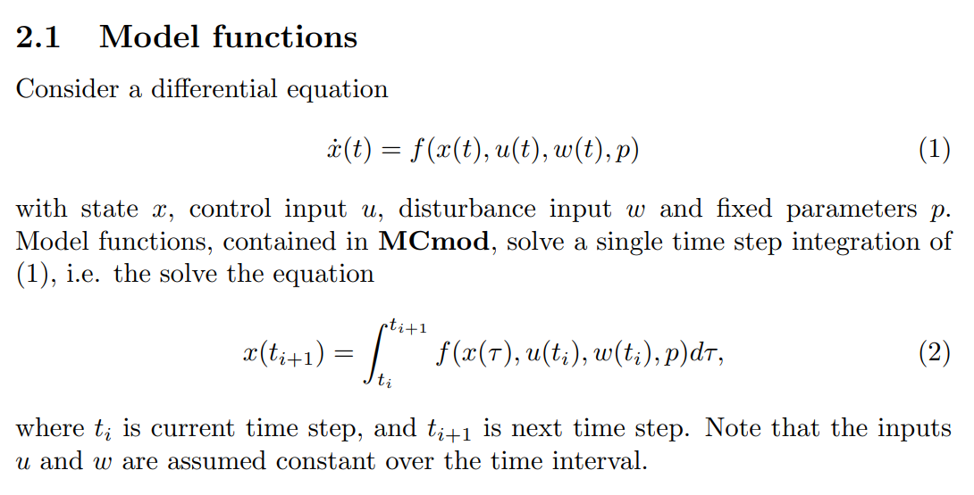
Model functions
Performs single time step integration of dynamic models
Arguments:
state, control input and disturbance input at current time step
Model parameters
Output:
state at next time step
Meeting notes: output time derivative instead, and do integration in script?

Slide 8
Model data
Post-meeting notes:
Can just use parM for model data. But should at least separate into a few different parameter dictionaries. E.g. parM for model data, parC for controller data etc.
Not set in stone, different projects may have different needs. But aim for a general format that is familiar.
The key idea is to use dictionaries, instead of a bunch of different variables as arguments. Having all the vessel data in parV and all the actuator data in parA is a clean way of organizing it. Can then create a dictionary parM containing parA and parV, or other objects as needed.
As a use example: parV may be input to both a model, and an observer. To emulate modelling error, we can create two dictionaries: parVtrue, used in the «true model», and parVobs, used in the observer (where the latter contains some error in the model parameters).
Model parameters are passed to functions using dictionary objects
parV: vessel parameters
parA: actuator parameters
Stored to file using pickle
RVG_3DOF_man.pkl
Avoid hard-coding parameters!
the RVG 3DOF man model can be used to model other vessels by using different model data

Slide 9
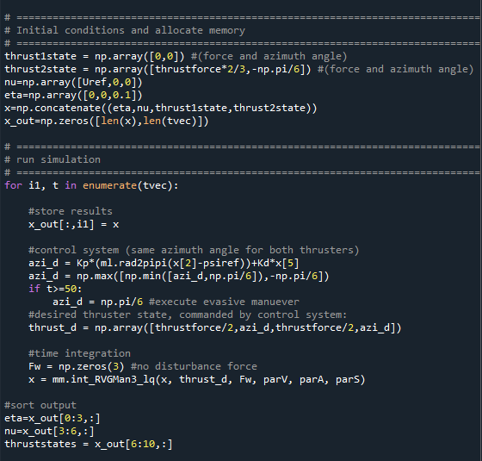
Using the toolbox
The main «user interface» is scripts that
Load model data from file
Initialize and run simulations by calling model functions in a for-loop

